Slide 1

David Spears and Tim Heard

Slide 2


Barclays Round-Up is a collaborative, micro donation initiative, enabling our customers to make a big difference with their small change.
As a optional bolt-on to their existing Barclaycard product, our customers opt in to automatically round up their purchases by a few pennies, with the money going towards funding early stage social enterprises that create a positive social impact in the UK and abroad.
How does it work?
Customers
Customer enables round up function via app
Customer chooses donation threshold and monthly cap
Customer selects social enterprise and location
Barclays
Barclaycard provide functionality and a choice of social enterprises
Barclaycard rounds up card purchases & channels funds to social enterprises
Social Enterprises
Successful early stage social enterprises use funds and provide a view of how the funds are making a difference

Slide 3
There are benefits for customer, for Barclays and for the social enterprises that the schemes support.
Who does it benefit?
Customers
Easier to donate to causes they care about
Doing good every day, without the hassle
Integrates donations seamlessly into customer lifestyles
Barclays
Drives profit via retention, attraction & increased transactions plus other brand benefits.
Minimal Run Costs, Minimal Op Impact, Minimal CTA
Social Enterprises
Potential to raise £millions for good causes
Win, Win, Win
Doing good, profitably, in a way that’s convenient & simple for our customers

Slide 4
Even if only a fraction of current Barclaycard users adopt Round-Up the social impact would be very significant
c9.5m
5%
20p
x
x
Personal Barclaycards currently in the UK
Adoption Rate
Average Round-up per month per user
=
£1.14m
For Social Enterprises every year
(Every 5p increase in average Round up = an extra £285,000 pa for social enterprises)

Slide 5




We’ve looked at previous examples to understand how similar initiatives have worked in other markets
Round Up Israel
Launched: 2009
125k subscribers, £1.47m raised to date
Germany Rounds Up
Launched: 2012
62m donations totalling €2.86m (between March 2012 – Sept 2014)
Pennies: The Digital Charity Box
Launched: 2010
14m micro-donations; £3m for UK charities
“Save the Change”
Launched: 2006
Customer can round up debit card transactions into their saving accounts
“If Barclays were prepared to pioneer the provision of the technical / financial Round-Up facility, I believe many of the influential organisations and people that have been supportive thus far would want to add considerable momentum to your cause”
Ray Taylor
Founder ; Round Up Israel

Slide 6
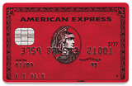


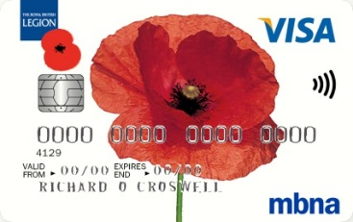

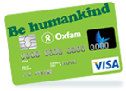

Barclaycard is well placed vs competitors to build a entrepreneurial proposition in contactless cards, and Round-Up would sit very well alongside the portfolio of other programmes Barclaycard currently supports.
Competitors Strategies
Current initiatives
Solely Charity Partnership focused
Highly innovative market leading offerings
Penny for London: 1p added to TFL journeys to support Mayor’s Fund for London
Freedom Rewards: Donate freedom rewards points earned to partnering charities such as Unicef and Marie Curie
Barclaycard Ring US: Virtual card member community allows members to share in profits based on collective decisions
AMEX: 1% of spend to RED global fund
MBNA: 25p for every £100 spent to charity
Co-Op: 25p for every £100 spent to charity
“There is room for a better donation method”
Firefish Survey Commissioned by Barclays

Slide 7
Barclaycard are uniquely positioned to successfully implement Round Up due to their scope, scale and expertise.
Barclaycard UK market share c.20% for both personal use and corporate use
c9.5 million personal customers, c400k business relationships
Great strength in 35-64 bracket but underperformance for younger demographics
Increased retention and customer base will lead to profit with c.30% customers ‘revolve’
In 2014 contactless payments made were £762m (from 126.5m transactions)
Barclaycard are clear market share leader across all metrics at a brand level. At a group level, Barclaycard leads in balance share and recently rose to the #1 spot in spend (#2 in new cards)
Competition: Little differentiation, highly saturated balance transfer and rewards market.
Market: Credit card borrowing continues to grow at a rate not seen since pre 2008; balances have reached a four-year high at £59.6 billion; average value of credit card transactions falls 11% in three years; the face of the rewards landscape is evolving

Slide 8




Initially we propose partnering with a third party institution who specialise in discovering and nurturing promising social enterprises
“Ashoka provide start-up financing, professional support services, and connections to a global network across the business and social sectors, and a platform for people dedicated to changing the world… increasingly look to entrepreneurial talent and new ideas to solve social problems”
The Bank of the Entrepreneur

Slide 9
Discovery funding would allow us to better explore the scope and feasibility of our initial concept and deliver a tangible proof of concept
Discovery Funding
Fund and pilot MVP
Impact Assessment
Market Research

Slide 10

Thank you for your time
Any questions?

Slide 11
Appendices
In-Depth Benefits, Product Story, Potential Causes, Challenges

Slide 12
Customer Benefits
Social Benefits
Makes donating to causes customers care about a part of their daily lives at a transactional level – easier to donate to causes which matter to them
We all want to have a positive impact on the world around us, but often fall short of having the time to do this – RoundUp will provide this opportunity.
Once opted in customers do not need to do anything else - Integrates fundraising into client lifestyles seamlessly without them having to make any changes to them
Customers will feel like they are ‘doing good’ without the hassle
Customers can opt in and opt out as they wish as well as providing preferences to make donations bespoke to them
Increasing trend towards “shopping for change” (Littler, 2008) – “Can we really buy our way to a better, more equitable or more sustainable future?”” Yes, with RoundUp we can.
Potential to raise millions for good causes with little cost or FTE impact on Barclays or any impact on customers’ daily ‘journeys’
We have partnered with development thought leaders in order to identify the most worthy causes which can act as a springboard (multiplier) for local communities.
We will also use thought leaders to donate direct to cause to save wasting raised money funding bureaucracy
The customers who sign up will automatically form a target population for future similar intraprenuerial ideas – thus this can act as a springboard for other ideas which will also have social benefit

Slide 13
Barclays’ Benefits
Ease of set up
Once up a running this will largely leverage existing infrastructure resulting in minimal run costs
We are not issuing a new product but adding functionality to existing products which minimises CTA
Most of the logistical functionality is already present to deliver Barclays RoundUp limited operational impact
Market Share
Encourages current customer loyalty to Barclaycard and the Barclays brand
Can be used as part of our Barclaycard offering to new clients in order to drive up market share in saturated markets i.e. the UK
Gives us an edge aside from just 0% APR on balance transfers for the longest time in terms of attracting new clients
This will allow us to engage with the needs and wants of a new generation of customers (Generation Y)
New channels for marketing and sales
Could give us the edge in markets where we are looking to expand rapidly i.e. the US
The customers who sign up will automatically form a target population for future similar intraprenuerial ideas – thus this can act as a springboard for other ideas
Strategic Alignment
Fundamentally aligns to Barclays’ Go-To strategy and the principles of TRANSFORM as well as our citizenship agenda 2020
Profit
Encourages individuals to spend on a Barclaycard as opposed to a debit card – increasing the chance of ‘revolving’
Increased number of customers will lead to an increased number of revolvers (currently 30%)
Increased number of transactions leads to an increased profit via interchange contributions of 0.3%
Brand image benefits
Potential investment return on social investments if we choose to take up this option
Social enterprises become business customers
Cross sell across group i.e. as a part of our corporate card offering

Slide 14

Product ‘Story’
Advertising campaign socialises the concept of ‘roundup’ and the ‘Barclays Charity Bucket’ (picking up on the contactless vs. change positioning)
Current Barclaycard customers can text “opt in” plus thresholds to a specific number advertised to register
Customers assign roundup and monthly thresholds i.e. 4p per transaction up to £4 per month
RoundUp starts collecting
This requires no change in customer spend behaviour/ product journeys
Extensions
Customers also get to assign preferences for donation i.e. type of cause and location Specialised bpay band issued to those who register
Monthly Newsletters are issued which detail the causes for the following month, an ‘opt out’ option and success stories from previous months

Slide 15

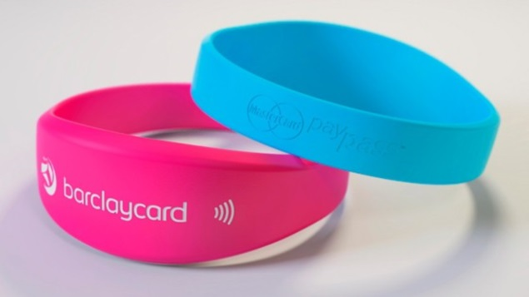
Extensions from the MVP
Gamification – Totalling of raised fund depicted via an enhanced Barclaycard App
Enhanced App itself – special features relating to roundup – change cost thresholds and preferences
Newsletters – track progress and impact of funds
Allow sharing of roundup materials/ donation totals etc. to create ‘net promoters’ – new channels for Barclaycard sales and marketing
Wearables – Bespoke Bpay band for RoundUp users
Preferences for donation – type, locations, Donate vs. Invest
Donation expansion from pennies to larger figures
Bespoke card to individual charities- allow net promotion of Barclaycard, new channels for selling and marketing

Slide 16
Challenges/Decisions
Do we match raised funds? If we don’t the product run costs are effectively ‘free’ but this could be more difficult to position with clients
Fundamentally will our clients sign up to ‘do good’? Historic products show that it is difficult to gauge client interest until the option is actually presented to them
How do we choose the causes to donate to? The preference for developmental thinkers is that we donate to developmental start ups as these have a multiplier effect on the local community and money is not ‘wasted’ on bureaucracy as per large charities.
How do we apply due diligence on the causes prior to selection?
Tech resource will be required to set up the roundup function within our Barclaycard payments platform. A roundup function is already present within Barclays (Pennies for London) but how complicated will it be to roll this out more generally. Tech and Design Office resource will be required to add new functionality to the Barclaycard app and to allow clients to track their donations/ make preference choices about them. A donations portal for the ‘Barclays Charity Bucket’ will need to be set up whereby the success of donations can be tracked and clients can suggest preference for location/type of cause
Will any of the changes impact on our BAU?
Invest raised funds in social causes with a potential return vs donate

Slide 17
Other
90% of Americans more likely to trust brands that back social causes (Cone Comms via Mashable)
90% more likely to trust and stay loyal to companies that actively try to makes difference
88% would buy a product with a social or environmental benefit
84% would tell family/friends about a company’s efforts
Contactless charity donations could mean the end of ‘chuggers’
Cancer Research UK trialling contactless payment points on charity shop windows
Digital giving study by Firefish
Our customers want an easy, safe and quick way to donate, that they are in control of
Openness to a different way of donating, specifically through an app

